Slide 1
Input system Android M Scan Wedge
Kacy
6/28/2016

Slide 2
Contents
Overview Frame Diagram
Kernel
Framework
Input Method &Scan Wedge
Analyze Kernel Part
Hardware
Initialization
Data Path
Analyze Framework Part
Data Path -> InputReadThread
Data Path -> InputDispatchThread
Analyze Input Method &Scan Wedge
Bind Input Method
Data Path
Scan Wedge Receiver
Implementation of “Wedge as Keys”
Solution 1
Solution 2
The End

Slide 3
Overview -> Kernel
/dev/input/eventX
/dev/input/mice
/dev/input/js
User Space
Console
Input Core
Virtual Terminal
Input Event Drivers
(mousedev, evdev, joydev, keyboard)
Input Device Drivers
Kernel Space
…
Serio
USB Hidp
Bluetooth Hidp
GPIO
Bluetooth Mouse
…
PS/2 Mouse
PS/2 Keyboard
USB Mouse
USB Keyboard
GPIO Keys
Hardware

Slide 4
Overview -> Framework
Input Manager Service
Windows Manager Service
ANR
Activity Manager Service
ANR
Start/Stop
ANR
Start/Stop
Register Channel
Launch
Input Reader
Input Dispatcher
ACK
Window Activity
User Space
Events
Events
Keys
Event Hub
Keys
Red line shows how the events go
/dev/input/eventX
/dev/input/mice
/dev/input/js

Slide 5
Overview -> Input Method &Scan Wedge
Window Activity
Bind Input method
to focus & Raw event data
Input Method Manager
Input Method Manager Service
Bind Input method
to focus & Raw event data
Input Method Service
Barcode
/other text
Barcode receiver
Red line shows how the barcode goes
Scan Wedge
Barcode

Slide 6
Contents
Overview Frame Diagram
Kernel
Framework
Input Method &Scan Wedge
Analyze Kernel Part
Hardware
Initialization
Data Path
Analyze Framework Part
Data Path -> InputReadThread
Data Path -> InputDispatchThread
Analyze Input Method &Scan Wedge
Bind Input Method
Data Path
Scan Wedge Receiver
Implementation of “Wedge as Keys”
Solution 1
Solution 2
The End

Slide 7
Overview -> Kernel
/dev/input/eventX
/dev/input/mice
/dev/input/js
User Space
Console
Input Core
Virtual Terminal
Input Event Drivers
(mousedev, evdev, joydev, keyboard)
Input Device Drivers
Kernel Space
…
Serio
USB Hidp
Bluetooth Hidp
GPIO
Bluetooth Mouse
…
PS/2 Mouse
PS/2 Keyboard
USB Mouse
USB Keyboard
GPIO Keys
Hardware

Slide 8
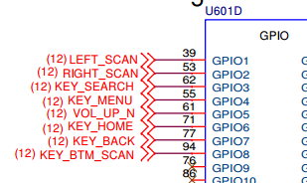
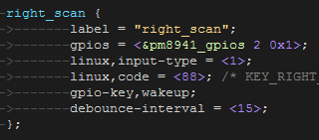
Analyze Kernel Part
Hardware
Example - Gpio keys
Schematic
Device Tree

Slide 9
Contents
Overview Frame Diagram
Kernel
Framework
Input Method &Scan Wedge
Analyze Kernel Part
Hardware
Initialization
Data Path
Analyze Framework Part
Data Path -> InputReadThread
Data Path -> InputDispatchThread
Analyze Input Method &Scan Wedge
Bind Input Method
Data Path
Scan Wedge Receiver
Implementation of “Wedge as Keys”
Solution 1
Solution 2
The End

Slide 10
Analyze Kernel Part
Initialization
Example - Gpio_key.c
static int __devinit gpio_keys_probe(struct platform_device *pdev)
{ // get gpio keys info from device tree
error = gpio_keys_get_devtree_pdata(dev, &alt_pdata);
// allocate an input device (struct input_dev).
input = input_allocate_device();
// set device data
input_set_drvdata(input, ddata);
// init gpio, irq; init work for irq
gpio_keys_setup_key(); // input_set_capability(input, EV_KEY, button);
// register input device (add struct input_dev to input device list)
error = input_register_device(input);
}

Slide 11
Analyze Kernel Part
Initialization
Example - Input.c
struct input_dev *input_allocate_device(void)
{
struct input_dev *dev;
// allocate memory
dev = kzalloc(sizeof(struct input_dev), GFP_KERNEL);
if(dev) {
// do some variable assignment for struct input_dev
……
}
return dev;
}

Slide 12
Analyze Kernel Part
Initialization
Example - Input.c
int input_register_device(struct input_dev *dev)
{ // set device name
dev_set_name(&dev->dev, "input%ld",
(unsigned long) atomic_inc_return(&input_no) - 1);
// put device into linux device module
error = device_add(&dev->dev);
// add node to input device list
list_add_tail(&dev->node, &input_dev_list);
// Link device to a handler
list_for_each_entry(handler, &input_handler_list, node)
input_attach_handler(dev, handler);
}

Slide 13
Contents
Overview Frame Diagram
Kernel
Framework
Input Method &Scan Wedge
Analyze Kernel Part
Hardware
Initialization
Data Path
Analyze Framework Part
Data Path -> InputReadThread
Data Path -> InputDispatchThread
Analyze Input Method &Scan Wedge
Bind Input Method
Data Path
Scan Wedge Receiver
Implementation of “Wedge as Keys”
Solution 1
Solution 2
The End

Slide 14
Analyze Kernel Part
Data Path
Example – Gpio_keys.c
static void gpio_keys_gpio_report_event(struct gpio_button_data *bdata)
{
input_event(input, type, button->code, !!state);
input_sync(input);
}

Slide 15
Analyze Kernel Part
Data Path
Example – Input.c
void input_event(struct input_dev *dev,
unsigned int type, unsigned int code, int value){
// report gpio keys
input_handle_event(dev, type, code, value);
}

Slide 16
Analyze Kernel Part
Data Path
Example – Input.c
static void input_handle_event(struct input_dev *dev,
unsigned int type, unsigned int code, int value)
{
// INPUT_PASS_TO_HANDLERS; INPUT_PASS_TO_ALL;
int disposition = INPUT_IGNORE_EVENT;
switch (type) {
case EV_SYN: …
case EV_KEY: …
}
if (disposition != INPUT_IGNORE_EVENT && type != EV_SYN)
dev->sync = false;
if ((disposition & INPUT_PASS_TO_DEVICE) && dev->event)
dev->event(dev, type, code, value);
if (disposition & INPUT_PASS_TO_HANDLERS)
input_pass_event(dev, type, code, value);
}

Slide 17
Analyze Kernel Part
Data Path
Example – Keyboard.c
static struct input_handler kbd_handler = {
.event = kbd_event,
…...
};
static void kbd_event(struct input_handle *handle, unsigned int event_type,
unsigned int event_code, int value)
{
kbd_keycode(event_code, value, HW_RAW(handle->dev));
}
static void kbd_keycode(unsigned int keycode, int down, int hw_raw)
{
put_queue(vc, keycode | (!down << 7));
}

Slide 18
Analyze Kernel Part
Data Path
Input device and handler are many to many relationships
Gpio_keys devices node
1
2
3
Input_register_device()
Input_dev_list
Handle key event
Input_handler_list
Input_register_handler()
1
2
3
Keyboard handler node

Slide 19
Contents
Overview Frame Diagram
Kernel
Framework
Input Method &Scan Wedge
Analyze Kernel Part
Hardware
Initialization
Data Path
Analyze Framework Part
Data Path -> InputReadThread
Data Path -> InputDispatchThread
Analyze Input Method &Scan Wedge
Bind Input Method
Data Path
Scan Wedge Receiver
Implementation of “Wedge as Keys”
Solution 1
Solution 2
The End

Slide 20
Overview -> Framework
Input Manager Service
Windows Manager Service
ANR
Activity Manager Service
ANR
Start/Stop
ANR
Start/Stop
Register Channel
Launch
Input Reader
Input Dispatcher
ACK
Window Activity
User Space
Events
Events
Keys
Event Hub
Keys
Red line shows how the events go
/dev/input/eventX
/dev/input/mice
/dev/input/js

Slide 21
Overview -> Framework
Service
App
WMS
Windows Stack
PhoneWindowManager
DecorView
WindowState
InputMonitor
IMS
NativeInputManager
ViewRootlmpl
InputManager
InputEventReceiver
InputDispatcher
InputConsumer
InputReader
Input Window Handle
InputChannel
Event Hub
Input Mapper
Domain socket
InputPublisher
Input
Channel
Input Mapper

Slide 22
Contents
Overview Frame Diagram
Kernel
Framework
Input Method &Scan Wedge
Analyze Kernel Part
Hardware
Initialization
Data Path
Analyze Framework Part
Data Path -> InputReadThread
Data Path -> InputDispatchThread
Analyze Input Method &Scan Wedge
Bind Input Method
Data Path
Scan Wedge Receiver
Implementation of “Wedge as Keys”
Solution 1
Solution 2
The End

Slide 23
Analyze Framwork Part
Data Path -> InputReadThread
Example - InputReader.cpp EventHub.cpp
void InputReader::loopOnce() {
// poll to read events from event hub
size_t count = mEventHub->getEvents(timeoutMillis,
mEventBuffer, EVENT_BUFFER_SIZE);
// preprocess events, put events to listener
processEventsLocked(mEventBuffer, count);
// process events in listener
mQueuedListener->flush();
}
size_t EventHub::getEvents(int timeoutMillis, RawEvent* buffer, size_t bufferSize)
{
// polling all devices in /dev/input/eventX -> find open read
// read all events
}

Slide 24
Analyze Framwork Part
Data Path -> InputReadThread
Example - InputReader.cpp
void InputReader::processEventsLocked(const RawEvent* rawEvents
, size_t count)
{
if (type == FIRST_SYNTHETIC_EVENT) {
processEventsForDeviceLocked(deviceId, rawEvent, batchSize);
} else {
// deal with device add/remove …
}
}
void InputReader::processEventsForDeviceLocked(int32_t deviceId,
const RawEvent* rawEvents, size_t count) {
device->process(rawEvents, count);
}
void InputDevice::process(const RawEvent* rawEvents, size_t count) {
mapper->process(rawEvent);
}

Slide 25
Analyze Framwork Part
Data Path -> InputReadThread
Input device and input mapper
InputReader
Input Device
Input Mapper
Input Reader Context
getEventHub()
getPolicy()
getListener()
Joystick
Mapper
TouchInput
Mapper
KeyboardInputMapper
NotifyArgs
Single
TouchInput
Mapper
Multi
TouchInput
Mapper
output

Slide 26
Analyze Framwork Part
Data Path -> InputReadThread
Example - InputReader.cpp
void KeyboardInputMapper::process(const RawEvent* rawEvent)
{
processKey(rawEvent->when, rawEvent->value !=0, keyCode,
scanCode, flags);
}
void KeyboardInputMapper::processKey() {
NotifyKeyArgs args(when, getDeviceId(), ……);
getListener()->notifyKey(&args);
}
void QueuedInputListener::notifyKey(const NotifyKeyArgs* args) {
// push key args to dispatcher queue
mArgsQueue.push(new NotifyKeyArgs(*args));
}

Slide 27
Analyze Framwork Part
Data Path -> InputReadThread
Example – InputListener.cpp
void QueuedInputListener::flush() {
size_t count = mArgsQueue.size();
for (size_t i = 0; i < count; i++) {
NotifyArgs* args = mArgsQueue[i];
// mInnerListener is InputDispatcher
args->notify(mInnerListener);
delete args;
}
mArgsQueue.clear();
}
void NotifyKeyArgs::notify(const sp<InputListerInterface>& listener) const {
// call notifyKey in InputDispather
listener->notifyKey(this);
}

Slide 28
Analyze Framwork Part
Data Path -> InputReadThread
Example – InputDispatcher.cpp
void InputDispatcher::notifyKey(const NotifyKeyArgs* args) {
KeyEvent event;
event.initialize(args->deviceId, args->source, args->action,
flags, keyCode, args->scanCode, metaState, 0,
args->downTime, args->eventTime);
// send to InputDispatcherPolicy, intercept key event before queue
// NativeInputManager->interceptKeyBeforeQueueing
// ----> InputManagerService.interceptKeyBeforeQueueing
// ----> InputMonitor.interceptKeyBeforeQueueing
// ----> PhoneWindowManager.interceptKeyBeforeQueueing
mPolicy->interceptKeyBeforeQueueing(&event, /*byref*/ policyFlags);
// wake up InputDispatcher thread
if (needWake) {
mLooper->wake();
}
}

Slide 29
Contents
Overview Frame Diagram
Kernel
Framework
Input Method &Scan Wedge
Analyze Kernel Part
Hardware
Initialization
Data Path
Analyze Framework Part
Data Path -> InputReadThread
Data Path -> InputDispatchThread
Analyze Input Method &Scan Wedge
Bind Input Method
Data Path
Scan Wedge Receiver
Implementation of “Wedge as Keys”
Solution 1
Solution 2
The End

Slide 30
Analyze Framwork Part
Data Path -> InputDispatchThread
Example – InputDispatcher.cpp
void InputDispatcher::dispatchOnce()
{
// real dispatch event to right target
if (!haveCommandsLocked()) {
dispatchOnceInnerLocked(&nextWakeupTime);
}
mLooper->pollOnce(timeoutMillis);
}

Slide 31
Analyze Framwork Part
Data Path -> InputDispatchThread
Example – InputDispatcher.cpp
void InputDispatcher::dispatchOnceInnerLocked(nsecs_t* nextWakeupTime)
{
switch (mPendingEvent->type) {
case EventEntry::TYPE_KEY: {
// dispatch as key events
done = dispatchKeyLocked(currentTime, typedEntry,
&dropReason, nextWakeupTime);
}
}
}

Slide 32
Analyze Framwork Part
Data Path -> InputDispatchThread
Example – InputDispatcher.cpp
bool InputDispatcher::dispatchKeyLocked(nsecs_t currentTime, KeyEntry* entry,
DropReason* dropReason, nsecs_t* nextWakeupTime) {
Vector<InputTarget> inputTargets;
// looking for target window where event should go
int32_t injectionResult = findFocusedWindowTargetsLocked(currentTime,
entry, inputTargets, nextWakeupTime);
// dispatch key event basing on inputTargets
dispatchEventLocked(currentTime, entry, inputTargets);
}

Slide 33
Analyze Framwork Part
Data Path -> InputDispatchThread
Example – InputDispatcher.cpp
void InputDispatcher::dispatchEventLocked(nsecs_t currentTime,
EventEntry* eventEntry, const Vector<InputTarget>& inputTargets)
{
for (; < inputTargets.size();) {
// get connection by inputTarget.inputChannel
ssize_t connectionIndex = getConnectionIndexLocked(
inputTarget.inputChannel);
sp<Connection> connection = mConnectionsByFd.valueAt(
connectionIndex);
// dispatch event to right connection
prepareDispatchCycleLocked(
currentTime, connection, eventEntry, &inputTarget);
}
}

Slide 34
Analyze Framwork Part
Data Path -> InputDispatchThread
Example – InputDispatcher.cpp
void InputDispatcher::prepareDispatchCycleLocked(nsecs_t currentTime,
const sp<Connection>& connection, EventEntry* eventEntry,
const InputTarget* inputTarget) {
enqueueDispatchEntriesLocked(currentTime, connection,
eventEntry, inputTarget);
}
void InputDispatcher::enqueueDispatchEntriesLocked(nsecs_t currentTime,
const sp<Connection>& connection, EventEntry* eventEntry,
const InputTarget* inputTarget) {
startDispatchCycleLocked(currentTime, connection);
}
void startDispatchCycleLocked (……){
status = connection->inputPublisher.publishKeyEvent(……);
}

Slide 35
Analyze Framwork Part
Data Path -> InputDispatchThread
Example – InputTransport.cpp
status_t InputPublisher::publishKeyEvent(……)
{
InputMessage msg;
msg.header.type = InputMessage::TYPE_KEY;
msg.body.key.seq = seq;
msg.body.key.deviceId = deviceId;
msg.body.key.source = source;
msg.body.key.action = action;
msg.body.key.flags = flags;
msg.body.key.keyCode = keyCode;
msg.body.key.scanCode = scanCode;
……
// send msg to channel &handler
return mChannel->sendMessage(&msg);
}

Slide 36
Contents
Overview Frame Diagram
Kernel
Framework
Input Method &Scan Wedge
Analyze Kernel Part
Hardware
Initialization
Data Path
Analyze Framework Part
Data Path -> InputReadThread
Data Path -> InputDispatchThread
Analyze Input Method &Scan Wedge
Bind Input Method
Data Path
Scan Wedge Receiver
Implementation of “Wedge as Keys”
Solution 1
Solution 2
The End

Slide 37
Overview -> Input Method &Scan Wedge
Window Activity
Bind Input method
to focus & Raw event data
Input Method Manager
Input Method Manager Service
Bind Input method
to focus & Raw event data
Input Method Service
Barcode
/other text
Barcode receiver
Red line shows how the barcode goes
Scan Wedge
Barcode

Slide 38
Contents
Overview Frame Diagram
Kernel
Framework
Input Method &Scan Wedge
Analyze Kernel Part
Hardware
Initialization
Data Path
Analyze Framework Part
Data Path -> InputReadThread
Data Path -> InputDispatchThread
Analyze Input Method &Scan Wedge
Bind Input Method
Data Path
Scan Wedge Receiver
Implementation of “Wedge as Keys”
Solution 1
Solution 2
The End

Slide 39
Analyze Input Method and Scan Wedge
Bind Input Method
Example – ViewRootImpl.java WindowManagerGlobal.java
public static IWindowSession getWindowSession() {
// Create input manager case for current application
InputMethodManager imm = InputMethodManager.getInstance();
}

Slide 40
Analyze Input Method and Scan Wedge
Bind Input Method
Example – ViewRootImpl.java
public void handleMessage(Message msg) {
switch (msg) {
// when focus changed, try to connect an input method
case MSG_WINDOW_FOCUS_CHANGED:
imm.onPreWindowFocus(mView, hasWindowFocus);
imm.onPostWindowFocus( … ); break;
// Input connection has been set up
case MSG_FINISH_INPUT_CONNECTION:
imm.reportFinishInputConnection(
(InputConnection)msg.obj);
case MSG_CHECK_FOCUS:
imm.checkFocus();
}
}

Slide 41
Analyze Input Method and Scan Wedge
Bind Input Method
Example – InputMethodManager.java
public void onPostWindowFocus(View rootView, View focusedView,
int softInputMode, boolean first, int windowFlags) {
if (startInputInner(rootView.getWindowToken(),
controlFlags, softInputMode, windowFlags)) {
return;
}
}
boolean startInputInner(IBinder windowGainingFocus, int controlFlags,
int softInputMode, int windowFlags) {
// create input connection data path
InputConnection ic = view.onCreateInputConnection(tba);
servedContext = new ControlledInputConnectionWrapper(vh.getLooper(),
ic, this);
// send request to input method manager service, try to link to an input method
res = mService.startInput(mClient,
servedContext, tba, controlFlags);
}

Slide 42
Analyze Input Method and Scan Wedge
Bind Input Method
Example – InputMethodManagerService.java
public InputBindResult startInput(IInputMethodClient client,
IInputContext inputContext, EditorInfo attribute, int controlFlags) {
return startInputLocked(client, inputContext, attribute, controlFlags);
}
InputBindResult startInputLocked(IInputMethodClient client,
IInputContext inputContext, EditorInfo attribute, int controlFlags) {
return startInputUncheckedLocked(cs, inputContext,
attribute, controlFlags);
}
InputBindResult startInputUncheckedLocked(@NonNull ClientState cs,
IInputContext inputContext, @NonNull EditorInfo attribute, int controlFlags) {
return startInputInnerLocked();
}

Slide 43
Analyze Input Method and Scan Wedge
Bind Input Method
Example – InputMethodManagerService.java
InputBindResult startInputInnerLocked() {
// start input method
// create connection
if (bindCurrentInputMethodService(mCurIntent, this, Context.BIND_AUTO_CREATE
| Context.BIND_NOT_VISIBLE | Context.BIND_NOT_FOREGROUND
| Context.BIND_SHOWING_UI)) {
……
}
}
private boolean bindCurrentInputMethodService()
{ // bind input method service
return mContext.bindServiceAsUser(service, conn, flags,
new UserHandle(mSettings.getCurrentUserId()));
}

Slide 44
Contents
Overview Frame Diagram
Kernel
Framework
Input Method &Scan Wedge
Analyze Kernel Part
Hardware
Initialization
Data Path
Analyze Framework Part
Data Path -> InputReadThread
Data Path -> InputDispatchThread
Analyze Input Method &Scan Wedge
Bind Input Method
Data Path
Scan Wedge Receiver
Implementation of “Wedge as Keys”
Solution 1
Solution 2
The End

Slide 45
Analyze Input Method and Scan Wedge
Data Path
Example – ViewRootImpl.java
private void deliverInputEvent(QueuedInputEvent q) {
stage.deliver(q);
}
public final void deliver(QueuedInputEvent q) {
apply(q, onProcess(q));
}
final class ImeInputStage extends AsyncInputStage
implements InputMethodManager.FinishedInputEventCallback {
protected int onProcess(QueuedInputEvent q) {
// dispatch events to input method manager
int result = imm.dispatchInputEvent(event, q, this, mHandler);
}
}

Slide 46
Analyze Input Method and Scan Wedge
Data Path
Example – InputMethodManager.java
public int dispatchInputEvent(InputEvent event, Object token,
FinishedInputEventCallback callback, Handler handler) {
// send the event immediately.
return sendInputEventOnMainLooperLocked(p);
}
int sendInputEventOnMainLooperLocked(PendingEvent p) {
mCurSender = new ImeInputEventSender(mCurChannel,
mH.getLooper());
// send the event immediately by ime sender
mCurSender.sendInputEvent(seq, event);
}

Slide 47
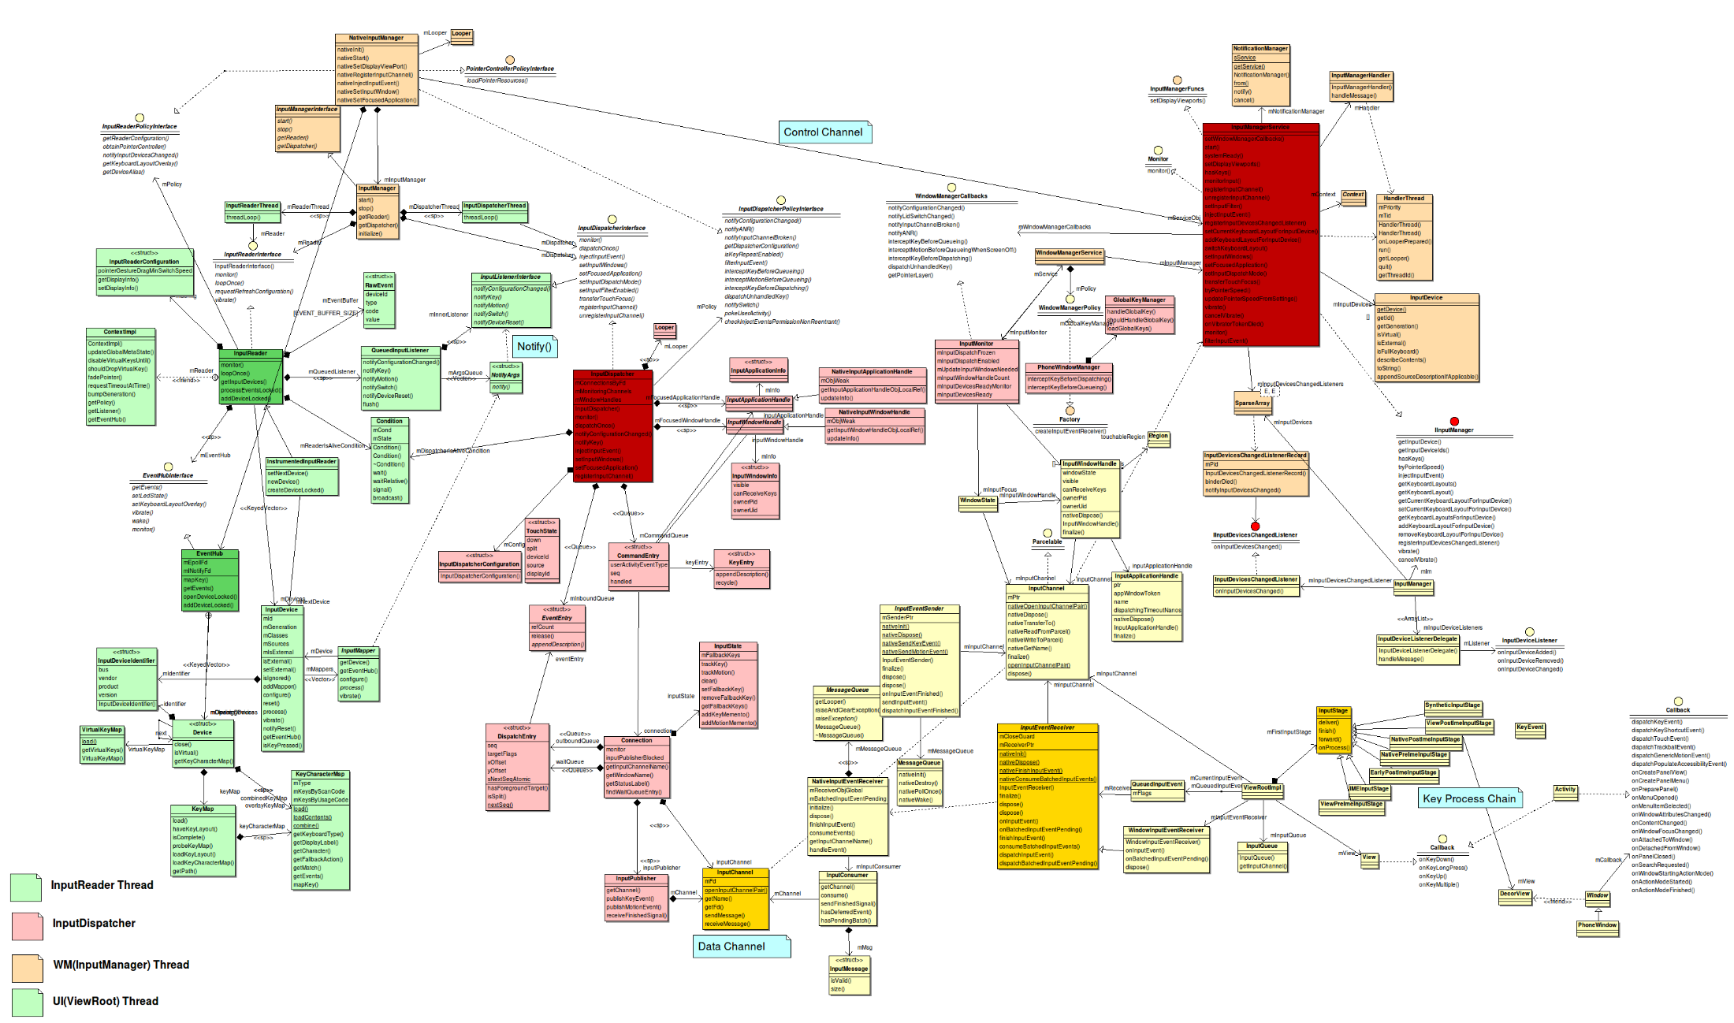

Slide 48
Contents
Overview Frame Diagram
Kernel
Framework
Input Method &Scan Wedge
Analyze Kernel Part
Hardware
Initialization
Data Path
Analyze Framework Part
Data Path -> InputReadThread
Data Path -> InputDispatchThread
Analyze Input Method &Scan Wedge
Bind Input Method
Data Path
Scan Wedge Receiver
Implementation of “Wedge as Keys”
Solution 1
Solution 2
The End

Slide 49
Analyze Input Method and Scan Wedge
Scan Wedge Receiver
Example – InputMethodService.java
private class ScanResultReceiver extends android.content.BroadcastReceiver {
public void onReceive(Context context, Intent intent) {
String result = intent.getStringExtra("decode_rslt");
onText(result);
}
private void onText(CharSequence text) {
InputConnection ic = getCurrentInputConnection();
if (ic == null) return;
// send text to current connection
ic.beginBatchEdit();
ic.commitText(text, 0);
ic.endBatchEdit();
}
}

Slide 50
Contents
Overview Frame Diagram
Kernel
Framework
Input Method &Scan Wedge
Analyze Kernel Part
Hardware
Initialization
Data Path
Analyze Framework Part
Data Path -> InputReadThread
Data Path -> InputDispatchThread
Analyze Input Method &Scan Wedge
Bind Input Method
Data Path
Scan Wedge Receiver
Implementation of “Wedge as Keys”
Solution 1
Solution 2
The End

Slide 51
Analyze Input Method and Scan Wedge
Solution 1
Put characters in Key Event
Input Device
New Honeywell Key Struct
Input Core
struct Key {
uint32_t seq;
nsecs_t eventTime __attribute__((aligned(8)));
int32_t deviceId;
int32_t source;
int32_t action;
int32_t flags;
int32_t keyCode;
int32_t scanCode;
int32_t metaState;
int32_t repeatCount;
nsecs_t downTime __attribute__((aligned(8)));
bool hasCharacters;
size_t characterCount;
char characters[1024];
inline size_t size() const {
return sizeof(Key);
}
} key;
Event Hub
Input Reader
Input Dispatcher
View Root
If (event.getCharacters() != null) {
InputMethodManager imm
= InputMethodManager.peekInstance();
if (imm != null
&& imm.commitText(event.getCharacters())) {
return FINISH_HANDLED;
}
}

Slide 52
Analyze Input Method and Scan Wedge
Solution 1
http://ch3uu0002.honeywell.com:8080/2101 http://ch3uu0002.honeywell.com:8080/2100 http://ch3uu0002.honeywell.com:8080/2109 http://ch3uu0002.honeywell.com:8080/2108
For we do not have a lot source code in solution. Put link at here.

Slide 53
Contents
Overview Frame Diagram
Kernel
Framework
Input Method &Scan Wedge
Analyze Kernel Part
Hardware
Initialization
Data Path
Analyze Framework Part
Data Path -> InputReadThread
Data Path -> InputDispatchThread
Analyze Input Method &Scan Wedge
Bind Input Method
Data Path
Scan Wedge Receiver
Implementation of “Wedge as Keys”
Solution 1
Solution 2
The End

Slide 54
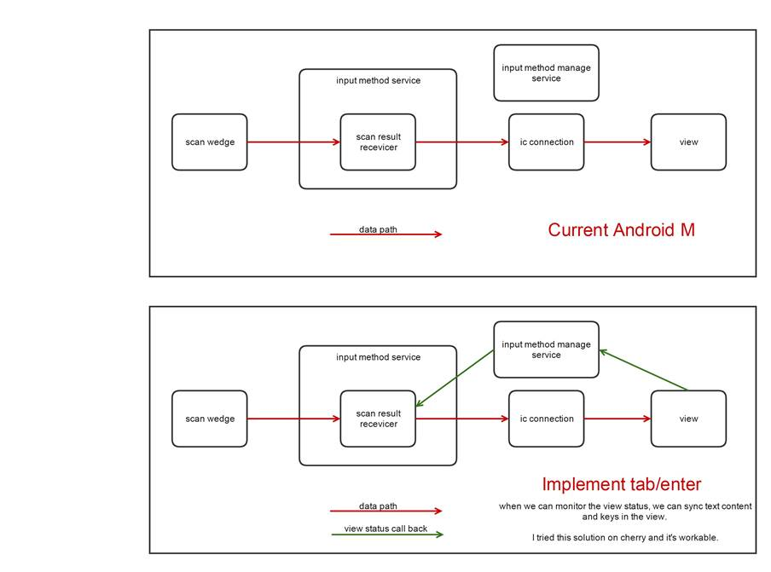
Analyze Input Method and Scan Wedge
Solution 2
Put KeyEvent in Characters

Slide 55
Analyze Input Method and Scan Wedge
Solution 2
http://ch3uu0002.honeywell.com:8080/#/c/8521/
For we do not have a lot source code in solution. Put link at here.

Slide 56
Discussion

Slide 57
The End
Thanks

